Slide 1


QCD Closure Tests 2016, 2017, 2018
George Bakas, Ioannis Papakrivopoulos

Slide 2
Overview
Efficiencies and Acceptance for mTT and jetPt variables
Selection:
Jet Matching
Parton cuts:
partonPt[0],[1] > 400
|partonEta[0],[1]| < 2.4
mTTbarParton > 1000
Reco cuts:
nJets > 1
nLeptons = 0
mJJ > 1000
jetPt[0],[1] > 400
|jetEta[0],[1]| < 2.4
bTagging cut (mediugm WP deepCSV) (2016: 0.6321, 2017: 0.4941, 2018: 0.4184)
Tagger cut (top Tagger) (2016: 0.2, 2017:0.0, 2018: 0.1)
JetMassSoftDrop > 120 GeV and < 220 GeV
TriggerBit

Slide 3
Purpose of this presentation
The QCD closure tests show the shape comparison between 3 regions
Signal Region (SR): all cuts shown before + 2btagged jets
Control Region (CR): same cuts as SR but btag cut is reverted (0 btag jets)
1bTag region: same cuts as SR but only 1 jet needs to be btagged
Control Region Contamination: Shows the percentage of the ttbar signal that passes the Control region cuts
For each year, different topTagger cut Working points + btag WP’s
QCD Closure Tests + ttbar CR contamination for variables:
mJJ: [1000, 1200, 1400, 1600, 1800, 2000, 2400, 2800, 3200, 4000, 5000]
ptJJ: [0,60,150,300,450,600,750,950,1100,1300]
yJJ: [-2.4,-1.5,-1.0,-0.5,0.0,0.5,1.0,1.5,2.4]
Leading and subleading jetPt: [400,450,500,570,650,750,850,950,1100,1300,1500]
Leading and subleading |jetY|: [0.0,0.2,0.4,0.6,0.8,1.0,1.2,1.4,1.6,1.8,2.0,2.2,2.4]

Slide 4
QCD Closure Tests
We have identified a problem regarding the shape of the QCD closure in 2017 and 2018 using the working points that we decided to work with (2017: 0.0 and 2018:0.1)
In these slides we show the different results using different WP’s in order to investigate whether the shape is inconsistent due to topTagger working points
Also we try to use different b-tagging technique (CSVv2 instead of deepCSV) only for 2016 and 2017 because there is no csvv2 WP for 2018

Slide 5
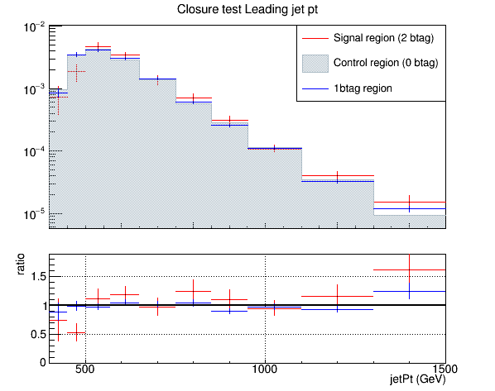
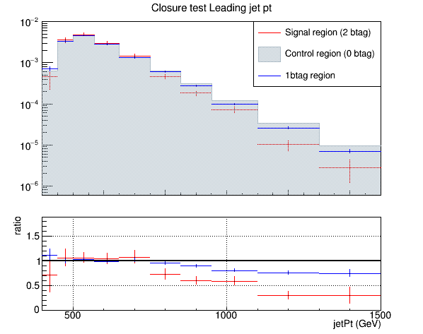
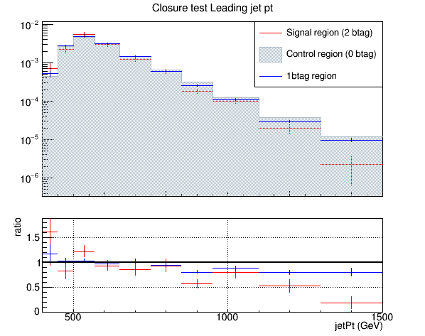
QCD Closure Tests ’16, ‘17, ’18 jetPt0
2016 topTagger 0.2, deepCSV
2017 topTagger 0.0, deepCSV
2018 topTagger 0.1, deepCSV

Slide 6

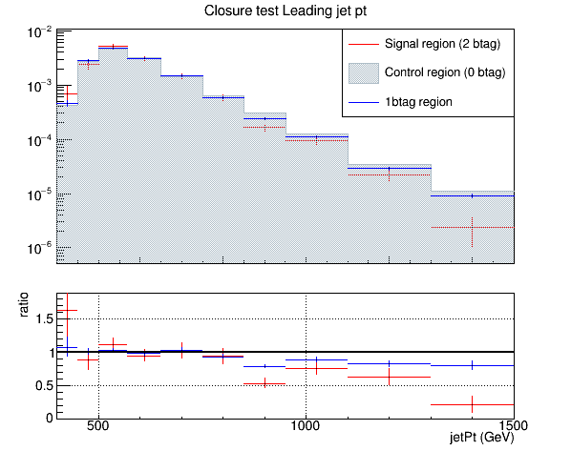
QCD Closure Tests ’16, ‘17, ’18 jetPt0
topTagger 0.0, deepCSV

Slide 7

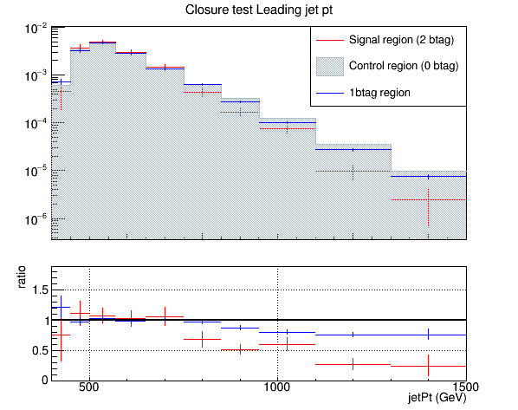
QCD Closure Tests ’16, ‘17, ’18 jetPt0
topTagger 0.1, deepCSV

Slide 8

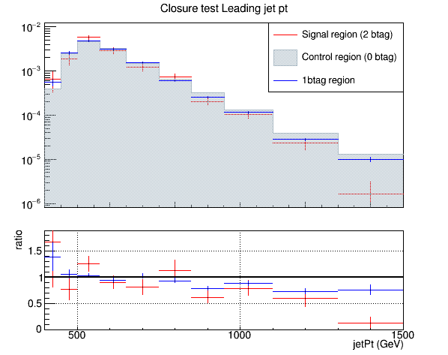
QCD Closure Tests ’16, ‘17, ’18 jetPt0
topTagger 0.2, deepCSV

Slide 9

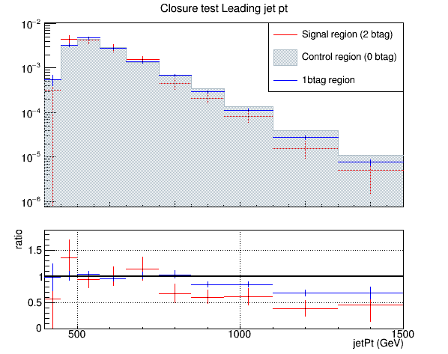
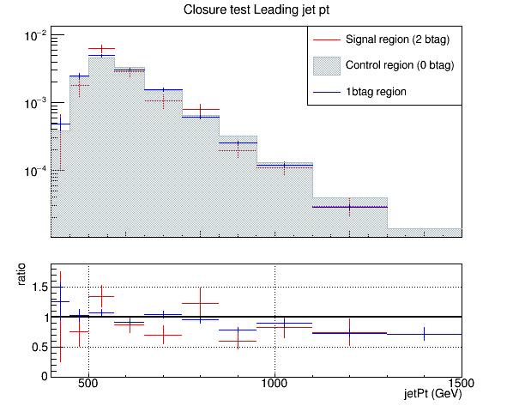
QCD Closure Tests ’16, ‘17, ’18 jetPt0
topTagger 0.3, deepCSV

Slide 10
QCD Closure Tests ’16, ‘17, ’18 jetPt0
jetMassSoftDrop (leading jet)

